Slide 1
Lending Club Case Study
Team:
Tushar Saxena
Sharath Raju

Slide 2
About
Lending Club is the largest online loan facilitating marketplace for personal loans, business loans and financing for medical procedures.
People in need can easily access loans with lower interest rates through their online portal.
Many of the lending companies goes through credit loss, which is the amount of money lost when the borrower refuses to pay or runs away with the money owed.
Our agenda here is to analysis the factors which contribute/influence the Defaulted cases, so that we can save the business from huge losses.

Slide 3
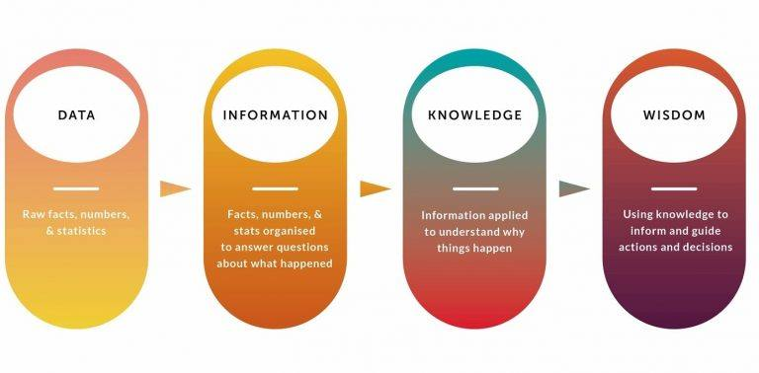
Exploratory Data Analysis

Slide 4
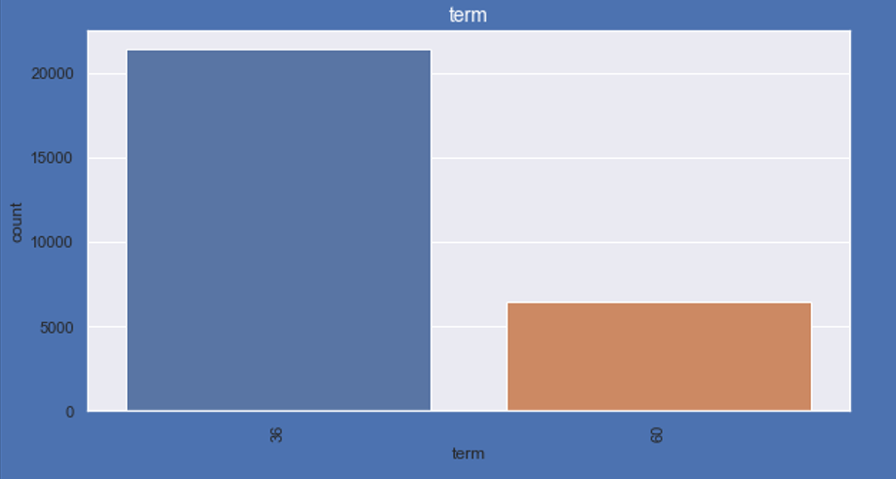
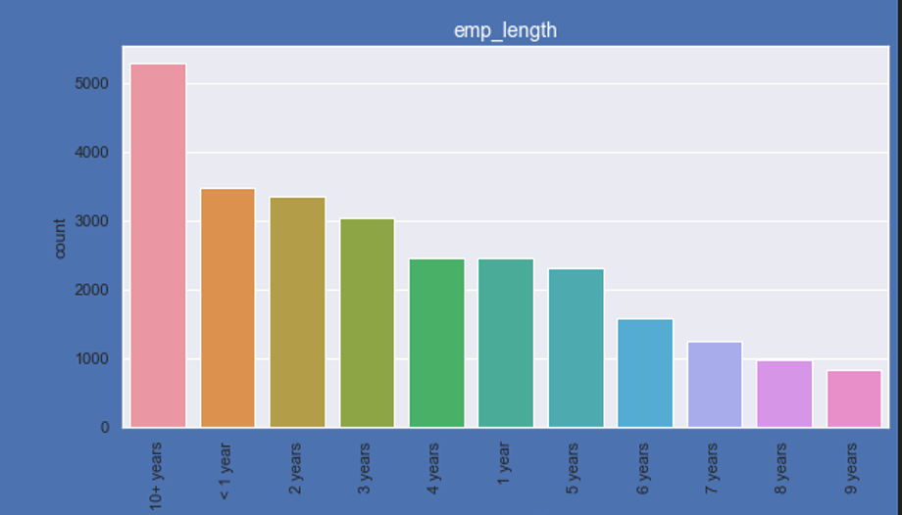
Analysis
In total there are two loan terms, 36 and 60 months and people with experience of more than 10+ years has taken more number of loans to meet their needs and commitments and second comes the people with less than 1 year of experience.
The number of loan applicants are declining as they gain experience .i.e. 1years to 9years and then it goes up

Slide 5
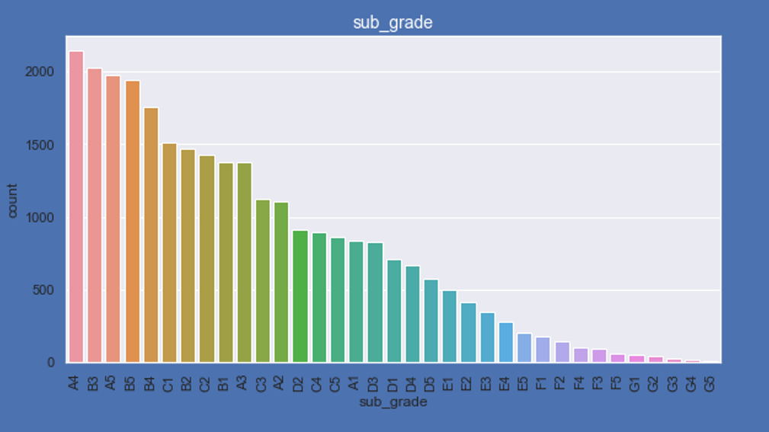
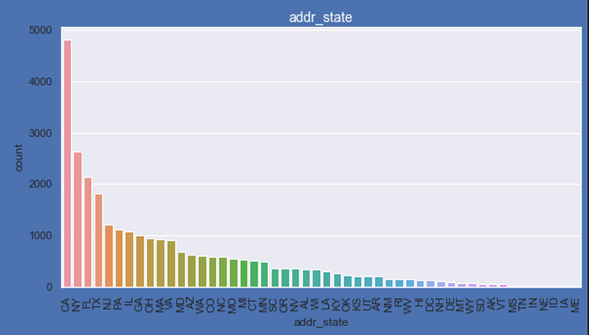
Analysis
Targeting the below categories would increase the sales of the company:
Most of the loans were taken by people from sub-grades like A4,B3,A5,B5,C1,B2 and C2.
People from the following states have taken most of the loans – CA,NY,FL,TX,NJ
For CA, there is a huge spike may be because of startups

Slide 6
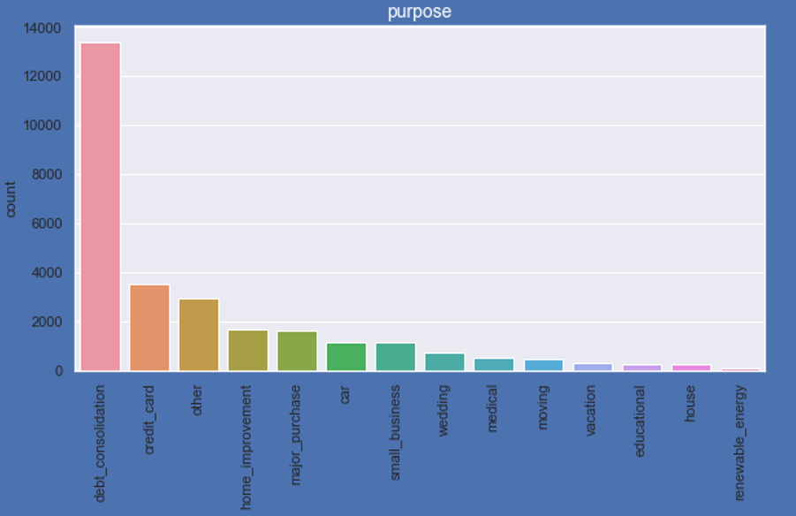
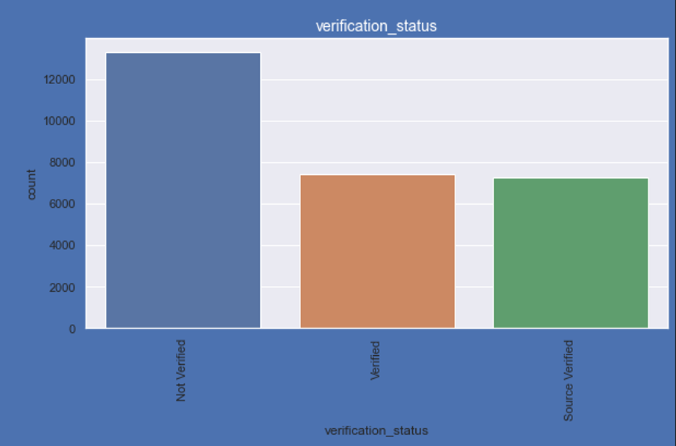
Analysis
Most of the loans were taken for the purpose of debt consolidation and credit card payments, while debt consolidation forms the major chunk.
50% of the loans approved were not verified, which should be taken care of to avoid any future consequences. As verifying the borrower’s provided information would give us more control over everything.

Slide 7
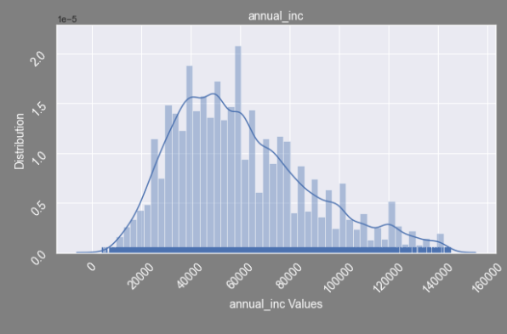
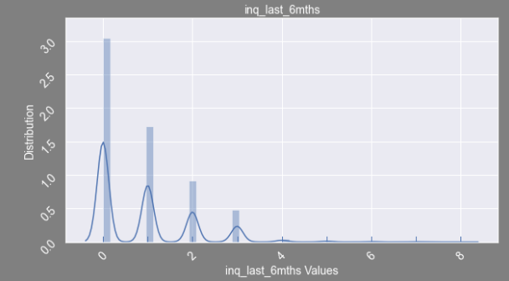
Analysis
Most of the applicants who took loans had an annual income in the range of 30-60k, which says most of them are individuals and are from middle class and doesn’t include bigger firms.
60% of the loans approved has zero inquiries done in the last 6 months, which says they had not applied for any loans recently.

Slide 8
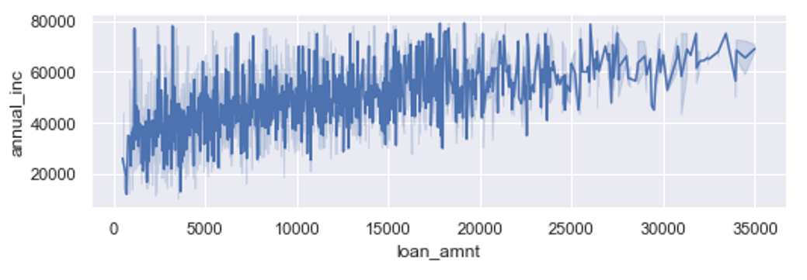
Analysis
Borrowers with more annual income than 60k have opted for more than average loan amounts, but the largest borrowers are those who makes between 40-50k annually

Slide 9
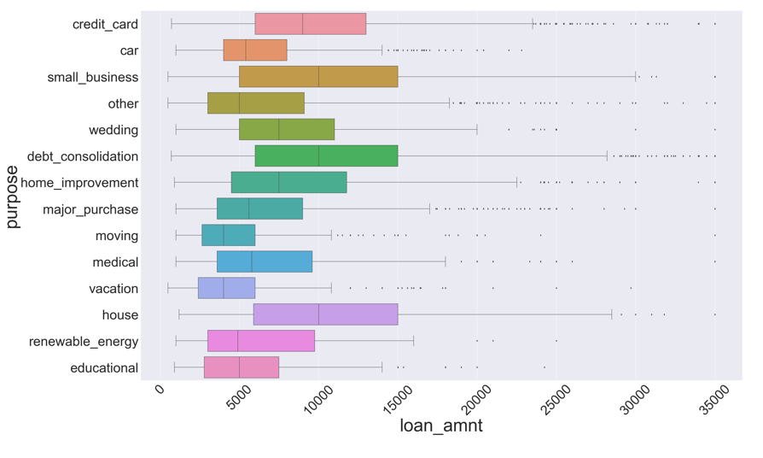
Analysis
Loans taken for the purpose of Small business, Debt consolidation and House involves huge sum of amounts compared to other mentioned purposes, the same information can be used to grow the business

Slide 10
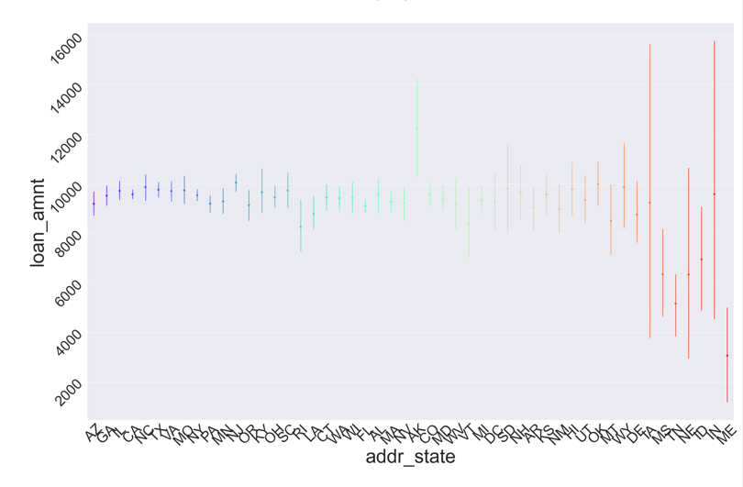
Analysis
Looks like borrowers from states like IA, NE and IN have taken varying amount of loans compared to other states

Slide 11
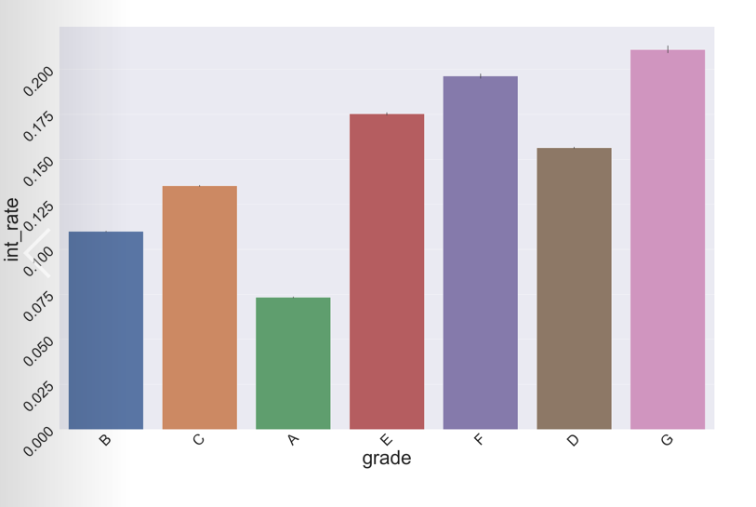
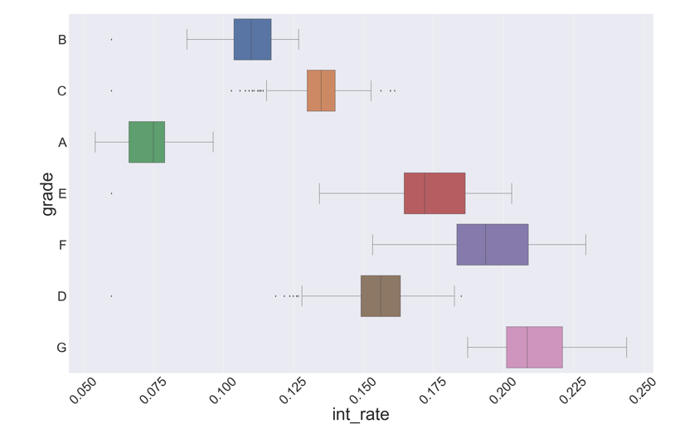
Analysis
People from D, E, F and G are willing to take loans with more interest rates than their counter parts, which might be an indicator that they have no other option or they have complications/obligations while applying for loans and getting them approved so they don’t bother about interest rates much.

Slide 12
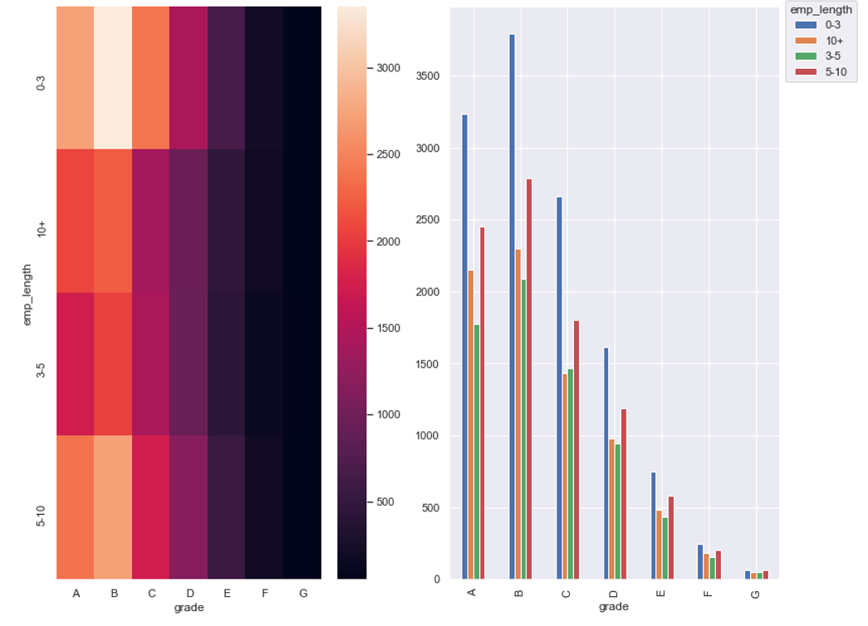
Analysis
The count of borrowers with 0-3 years and 5-10 years experience, are more in every grade than others Company can grow its business by concentrating more on this segments by creating marketing campaigns.

Slide 13
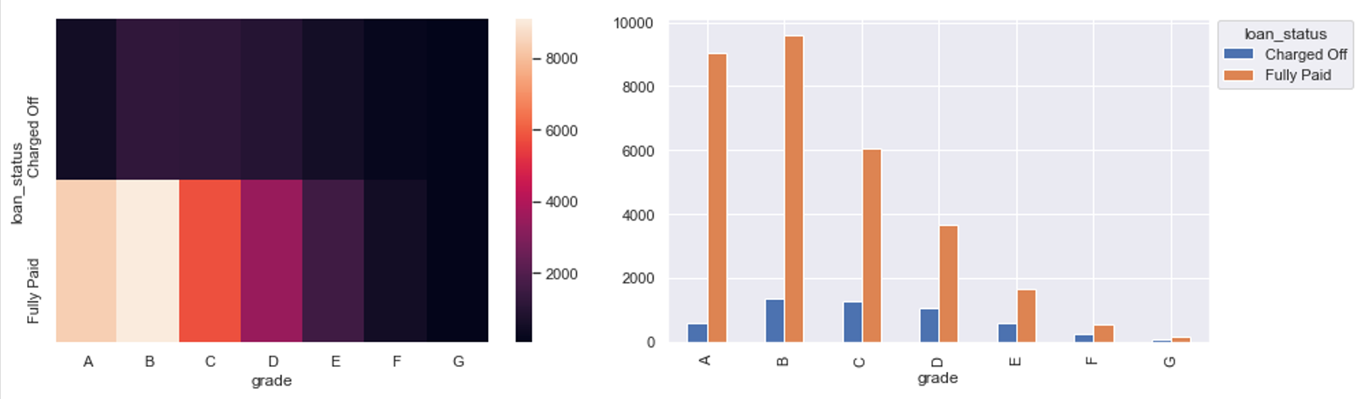
Analysis
Borrowers from grade B, C and D have defaulted more than other grades, and grade G has the least defaulters because of the lesser loans taken in that category which in turn might have been because of high interest rate charged on them as observed earlier.

Slide 14
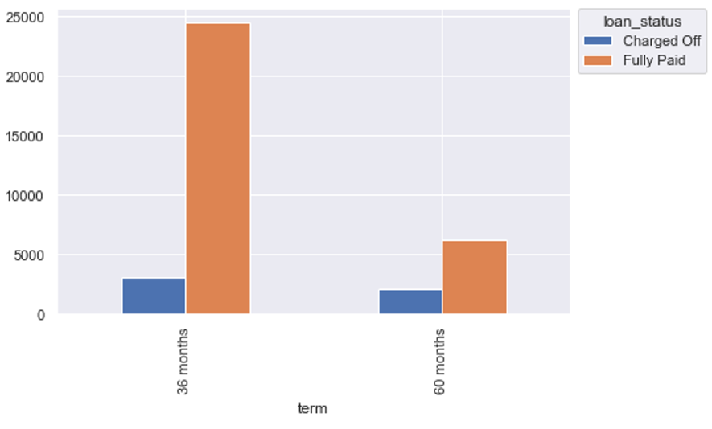
Analysis
33% of borrowers who had opted for 60 months term has defaulted, which might have been because of unseeable financial situation that came along there way as it’s a long period of time

Slide 15
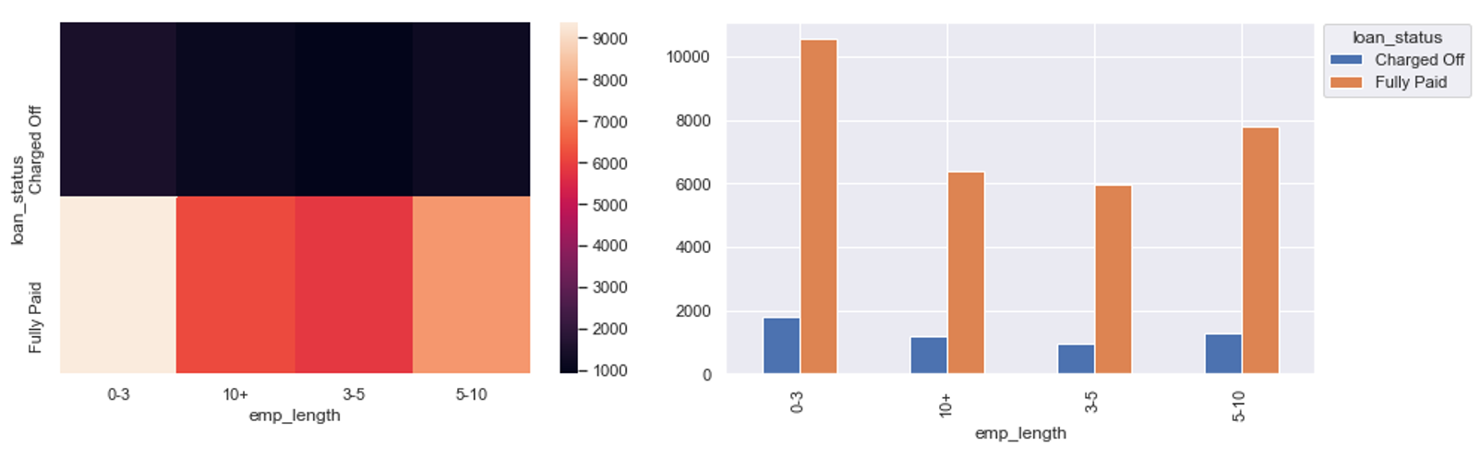
Analysis
The probability of borrowers with years of experience between 0-3 and 10+ defaulted is more than others comparatively.
Because 0-3 years people are more prone to unstable income and 10+ years have many commitments and much expenses to handle, which in turn affects paying back the loan amount in many cases.

Slide 16
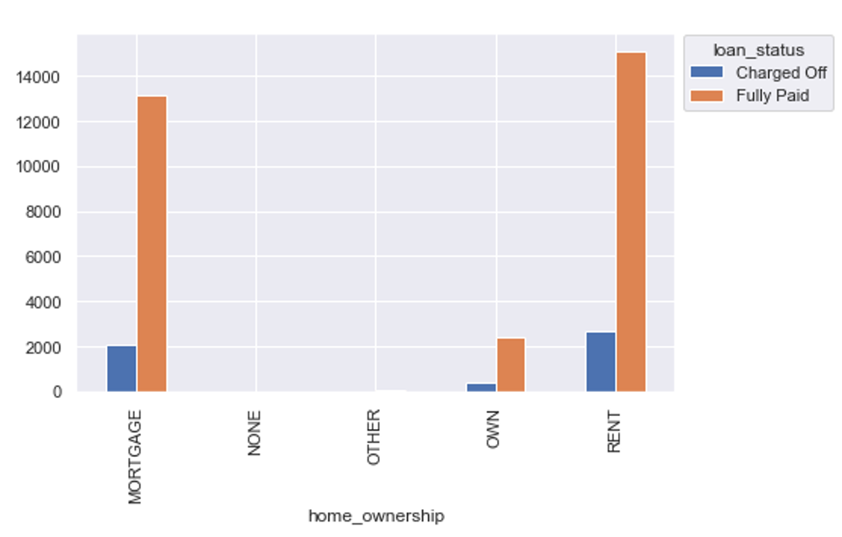
Analysis
Looks like home ownership in not a major contributing factor in defining the defaulters as in all the cases, defaulting to non-defaulting percentage remains almost similar.
Most of the borrowers live on rent or have mortgage to pay and few of the actually own a house

Slide 17
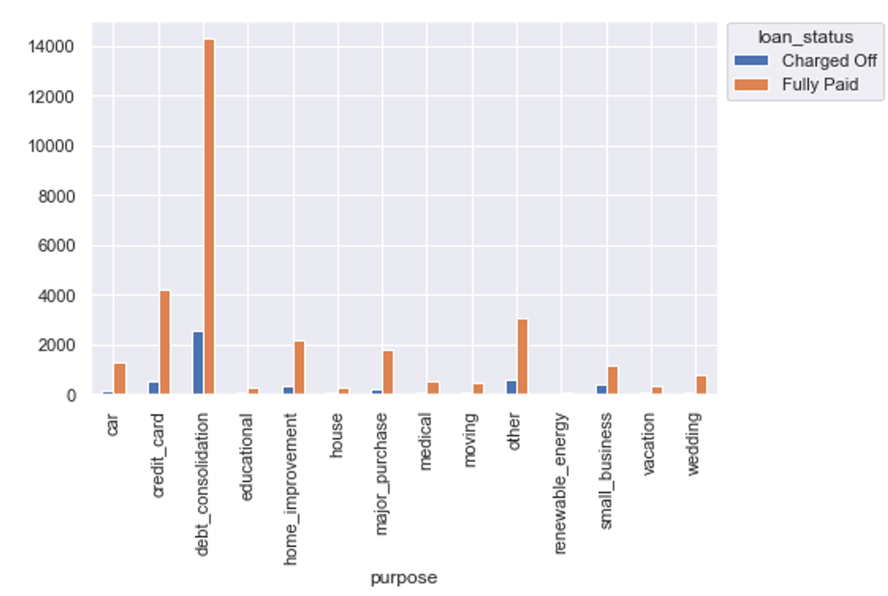
Analysis
18% of the people who has opted for debt consolidation and 30% of who opted for small business has actually defaulted more which is comparatively high compared to purposes like credit card payments and small business.
Debt consolidation has much defaulters as they already has other loans to be closed and run out of money as they are habituated to taking loans and small business might have defaulted as they ran out of funds due to losses
Loans taken for renewable energy is very less as its a new technology and might not be aware of it.

Slide 18
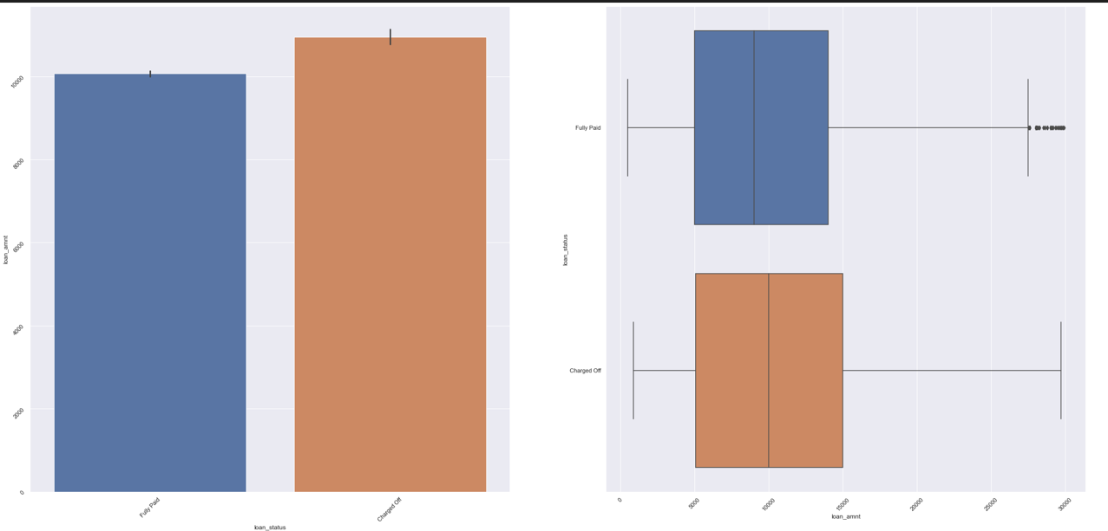
Analysis
Cases of defaulters are more when the loan amount is higher than 100k, which might be because of difficulty while paying back that much of an higher amount in high interest and lower annual income cases

Slide 19
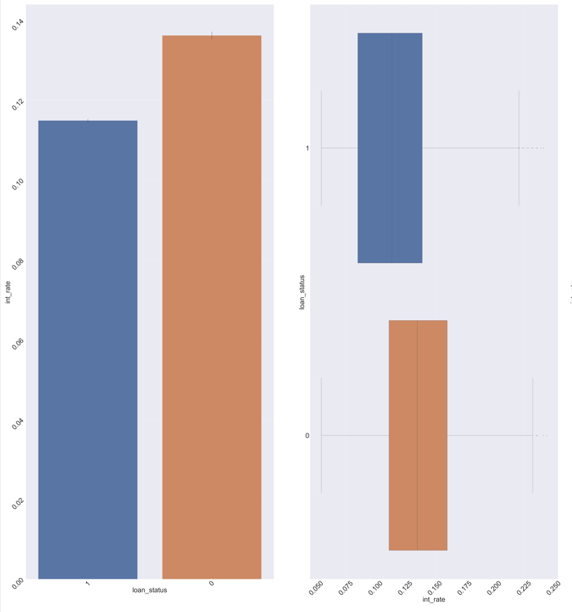
Analysis
Cases of defaulters has taken a plunge when the interest rates are higher than 12.5% and above, the possible reason could be that they might have felt that with that huge interest rates that they could never be able to pay off the principle and close the loan, so they defaulted.

Slide 20
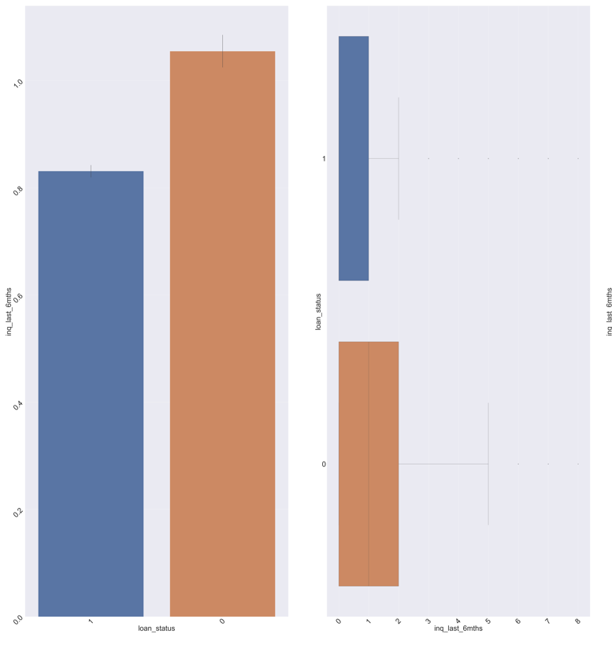
Analysis
The applicants for whom the number of inquiries in the last 6 months were equal to or more than 1, the chances of them being defaulters were more as per the analysis
Which might be because people have taken other loans too recently and those EMIs piled up all together, which hindered his paying capability

Slide 21
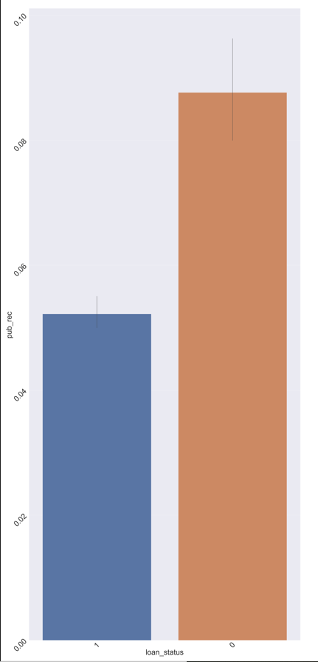
Analysis
The borrowers for whom pub rec count was equal to or more than 5, the chances of them being defaulters were more

Slide 22
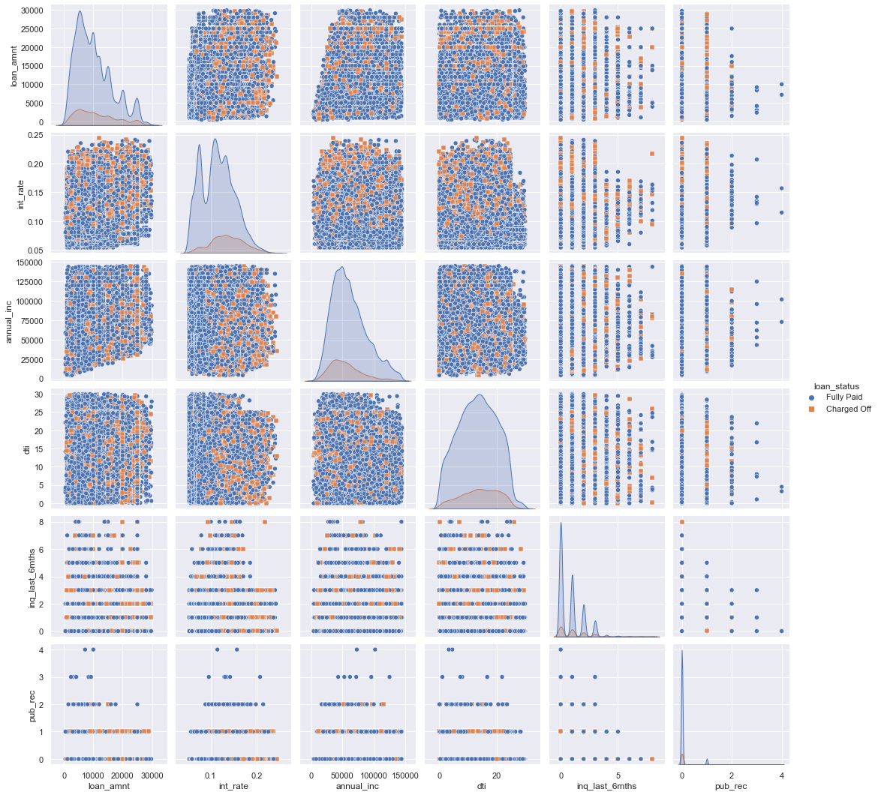
A consolidated visual chart portraying all the influencing factors for defaulters

Slide 23
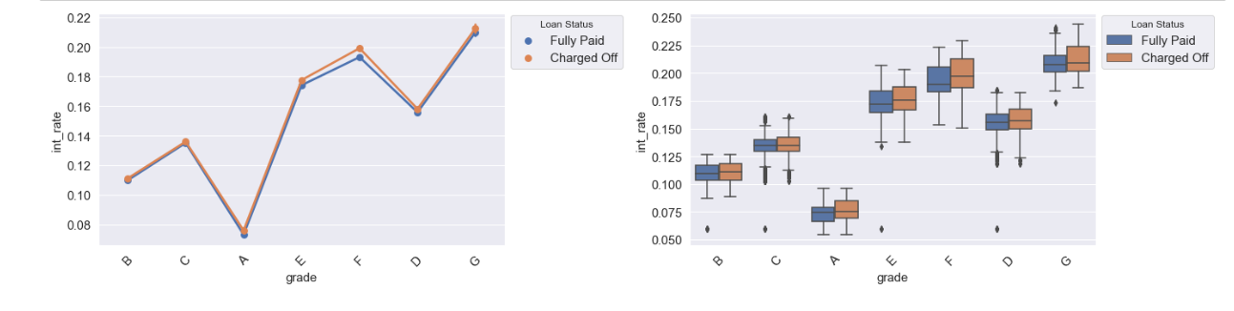
Analysis
Grade A has the lowest interest rates. As the grade goes from A to G, the interest rates goes up The average interest rates does not affect the loan defaulting in grade A, B and C, in others it's increase becomes a factor.
People from D, E, F and G are willing to take loans with more interest rates than their counter parts, which might be an indicator that they have no other option or they have complications/obligations while applying for loans and getting them approved so they don't bother about interest rates much.

Slide 24
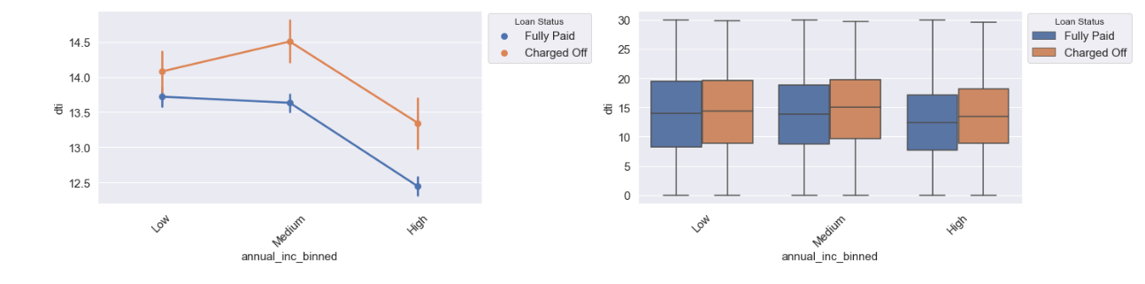
Analysis
Defaulters have higher DTI than non-defaulters. For medium annual income, DTI for fully paid loans actually decreased from low annual income, on the other hand it increased for defaulters.
More than average DTI can be a factor for defaulters. Generally the DTI trend should be downwards as, maybe beacuse of more purchasing power.

Slide 25
Recommendations
Loans of 60 terms should be limited for someone with being a defaulter profiler
Bank should avoid approving loan for someone with pub rec value >= 5
Borrowers for whom the number of inquiries in the last 6 months were >=1 should be not encouraged much
Loans for which Interest rates are higher than 13.5% and above, the investor can expect a higher risk and decide whether to proceed or step back.
Investors should be very cautious while the loan amounts are above 100k, in possible situations they should be avoided.
More than 20% of loans taken on purpose of debt consolidation and small business have defaulted so, considering all the above factors for these applicants is very crucial to avoid any losses.
Approving the lesser than eligible amount for 0-3 years and 10+ experienced applicants would be a better choice as they defaulted the most compared to others.

Slide 26
Recommendations
The number of loans being approved for 60 months term should be brought down
Borrowers from grade B, C and D have defaulted more , so considering the important factors that in increases the probability of him being a defaulter should be evaluated thoroughly
DTI on an average should decrease as the income bar increases. It should preferably be less than 13.7
Borrowers from AK and TN states should given loan after verified other factors mentioned here.

